Slide 1

MERN – ES6 + React
Module 01 : HTML Basics
1

Slide 2

Outline
Module 01
▸ HTML Basics
▸ Explaining Tagging concept
▸ List creation and display
▸ Divs and Spans creation
▸ Attributes and information display
2

Slide 3
HTML Basics
Client-side development
▸ What is HTML?
<!DOCTYPE html>
<html>
<head>
<title>Page Title</title>
</head>
<body>
- HTML stands for Hyper Text Markup Language
- HTML is not a programming language
- HTML describes the structure of a Web page
- HTML consists of a series of elements
- HTML elements tell the browser how to display the content
<h1>My First Heading</h1>
<p>My first paragraph.</p>
</body>
</html>
3

Slide 4
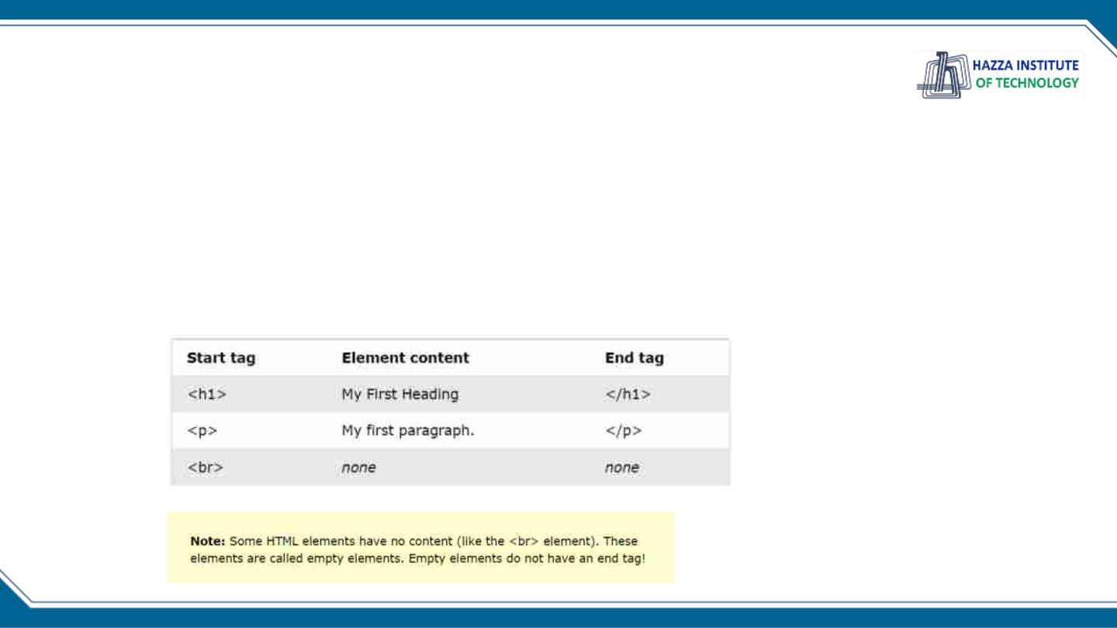
HTML Basics
Client-side development
▸ What is an HTML Element?
- An HTML element is defined by a start tag, some content, and an end tag:
- The HTML element is everything from the start tag to the end tag:
<tagname> Content goes here... </tagname>
<!DOCTYPE html>
<html>
<head>
<title>Page Title</title>
</head>
<body>
<h1>My First Heading</h1>
<p>My first paragraph.</p>
</body>
</html>
4

Slide 5
HTML Basics
Client-side development
▸ What are an HTML Attributes ?
- All HTML elements can have attributes
- Attributes provide additional information about elements
- Attributes are always specified in the start tag
- Attributes usually come in name/value pairs like: name="value"
<img src="img.jpg" width="500" height="600">
Examples
• The href attribute of <a> specifies the URL of the page the link goes to
• The src attribute of <img> specifies the path to the image to be displayed
• The width and height attributes of <img> provide size information for images
• The style attribute is used to add styles to an element, such as color, font, size,
and more
• The alt attribute of <img> provides an alternate text for an image
5

Slide 6
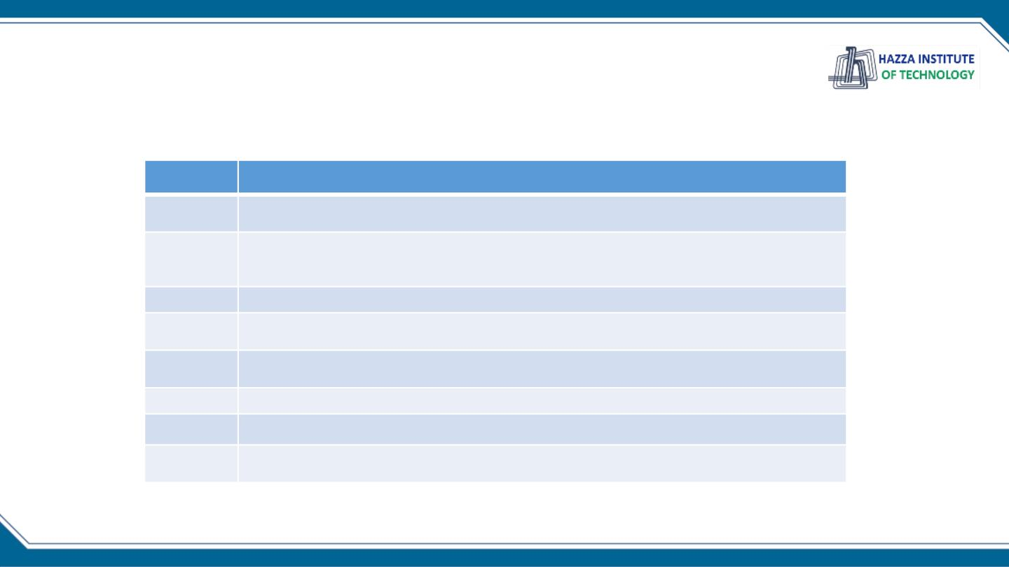
Evolution of HTML
Browser WAR?
Year
HTML Version
1993
HTML 1.0 - Developed by Tim Berners-Lee to link document
1995
HTML 2.0 - Developed by Internet Engineering Task Force RFC to include
stylized text and tables
1996
CSS 1
1997
HTML 3.2 – Developed by W3C and included browser specific features
1997
HTML 4.0 – A move back to normalizing the pages across platforms.
1998
CSS 2
1999
2012
HTML 4.01 – Introduced different document types
HTML 5 - Back to HTML plus multimedia and semantic tags

Slide 7

How to use an Editor to Create an HTML File
Creating and Editing Your Files
1. Decide how you will organize your files
2. Decide on a naming convention
– dash-names, CamelCase
– No spaces, Consistent capitalization
3. Decide on an editor
– Windows (Notepad, Notepad++, Sublime, VS
Code)
– Mac (TextEdit, TextWrangler,Sublime, VS
Code)

Slide 8
How to use an Editor to Create an HTML File
Getting Started
1. Open your editor
2. Select Save or Save As and name your file.
You may need to create a new folder first
3. Add Doctype, head, and body tags
4. Save File (Ctrl-S or Command-S)
5. Open in browser

Slide 9

The Document Object Model (DOM)
Document Object Model
Writing clean code

Slide 10
The Document Object Model (DOM)
The Document Object Model (DOM)
• Basis of HTML5 is “New features should be based
on HTML, CSS, the DOM, and JavaScript…”
• DOM provides common tree-like structure that all
pages should follow
• Computer Scientists love trees (the mathematical
kind) because you can test them.

Slide 11
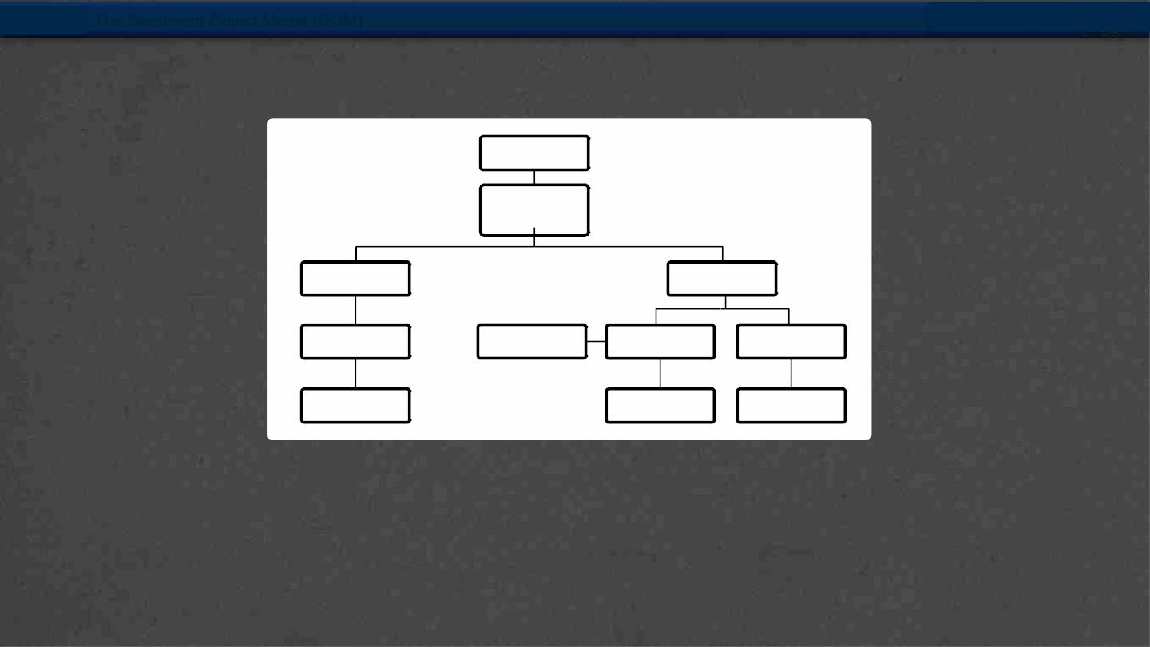
The Document Object Model (DOM)
HTML is built on the DOM
Document
Root
element
<html>
Element
<head>
z
Element
<body>
Element
<title>
Attribute
“href”
Element
<a>
Element
<h1>
Text
Text
Text
“my title”
“my link”
“my header”
Adapted from w3Schools.com

Slide 12
The Document Object Model (DOM)
Three parts of a well-formed document
• Doctype
• Version of HTML that you will be using
• Head
• Metadata
• Body
• Displayable content

Slide 13
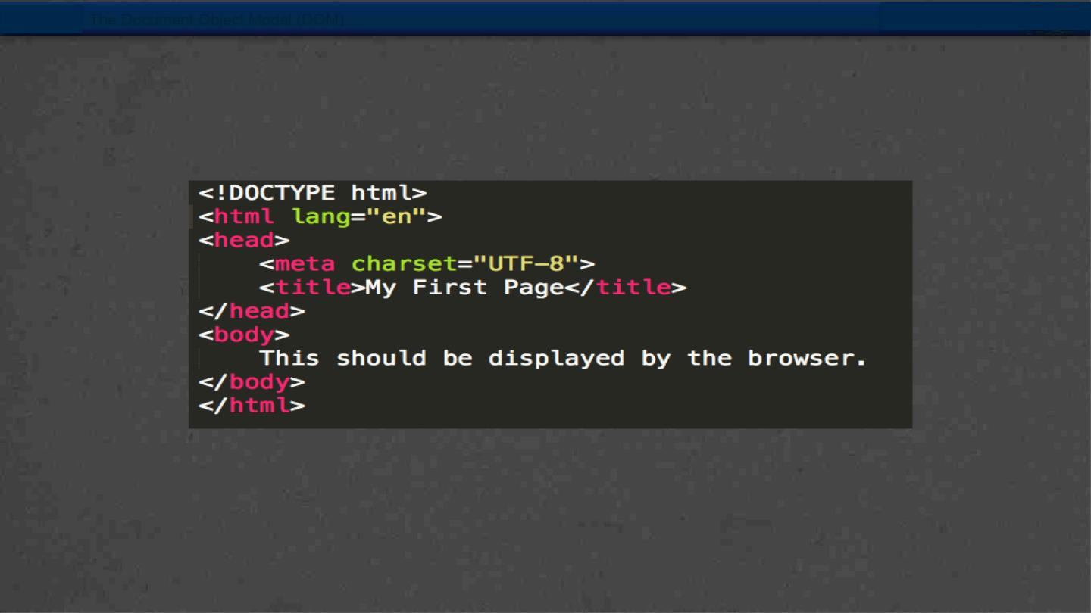
The Document Object Model (DOM)
Example
• Example: template.html

Slide 14
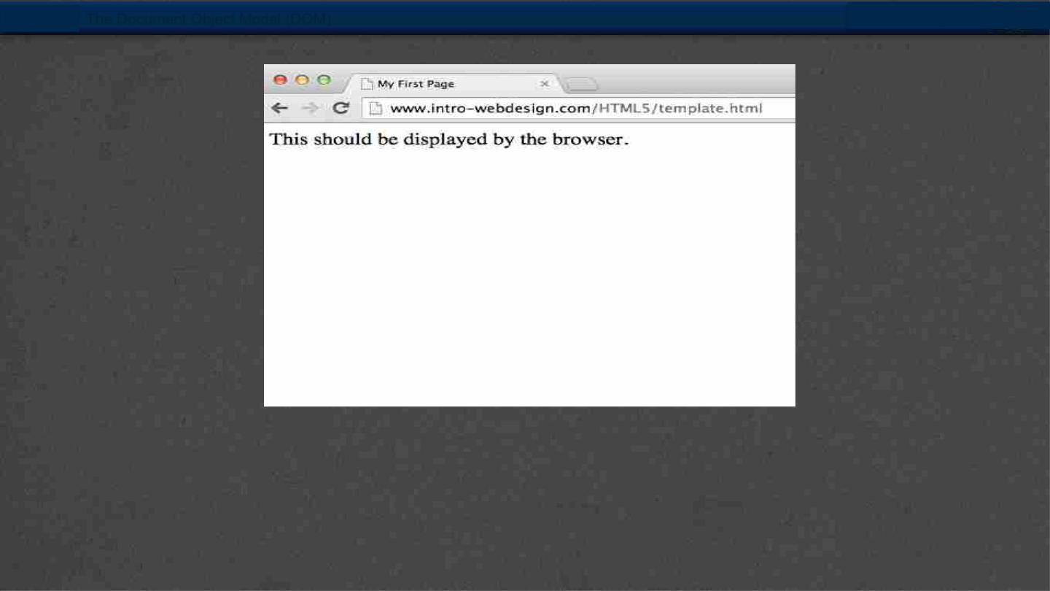
The Document Object Model (DOM)

Slide 15

HTML5 Tags and Syntax
Display
• One of the most important attributes of an
element is its display. The two most common are
block and inline
§ block (can take width and height)
§ Newline is inserted before and after, e.g. it “Takes up”
whole width
§ inline (can not take width and height)
§ Only uses as much space as needed to contain the
element.

Slide 16
HTML5 Tags and Syntax
Common Tags
• Headings (block)
• <h1>, <h2>, <h3>, <h4>, <h5>, <h6>
• These tags have syntax and semantics
• Paragraphs (block)
• <p> …. </p>
• Should only contain inline elements
• Divs (block)
• <div>...</div>
• Generic section that is larger than a
paragraph

Slide 17
HTML5 Tags and Syntax
More tags
• Ordered lists
<ul>
<li> Item One </li>
<li> Item Two </li>
</ul>
<ol>
<li> Item One </li>
<li> Item Two </li>
</ol>
• Unordered lists
• Line breaks
<br>

Slide 18
HTML5 Tags and Syntax
Attributes
• Attributes provide additional information
about an element
• Always specified in the start tag
• Attributes come in name/value pairs

Slide 19
HTML5 Tags and Syntax
Images
• Images (inline)
<img src = “myPicture.jpg” alt = “Image of
Colleen”/>
• Images rarely work the first time
• Show a broken link, too big, too small, etc.
• Save yourself heartache and size/carefully name
your picture before you use it.

Slide 20
HTML5 Tags and Syntax
More Attributes
• As you learn the tags, you learn their specific
attributes. Some apply to any tag
• class – applies special properties to groups of
elements
• id – specifies a unique id to one element on the
page
• style – specifies a certain visual style (avoid this
one!!!)
• accesskey – a shortcut key to activate an element
• tabindex – the order elements will come into focus
using the tab key.

Slide 21

Semantic Tags
Semantic HTML5 Tags
Making the most of the new tags

Slide 22

How to Design
• The most important step in web design is the
design.
• You need a clear picture of what you want to
create, before you can begin coding.
• Think wireframes !!!

Slide 23
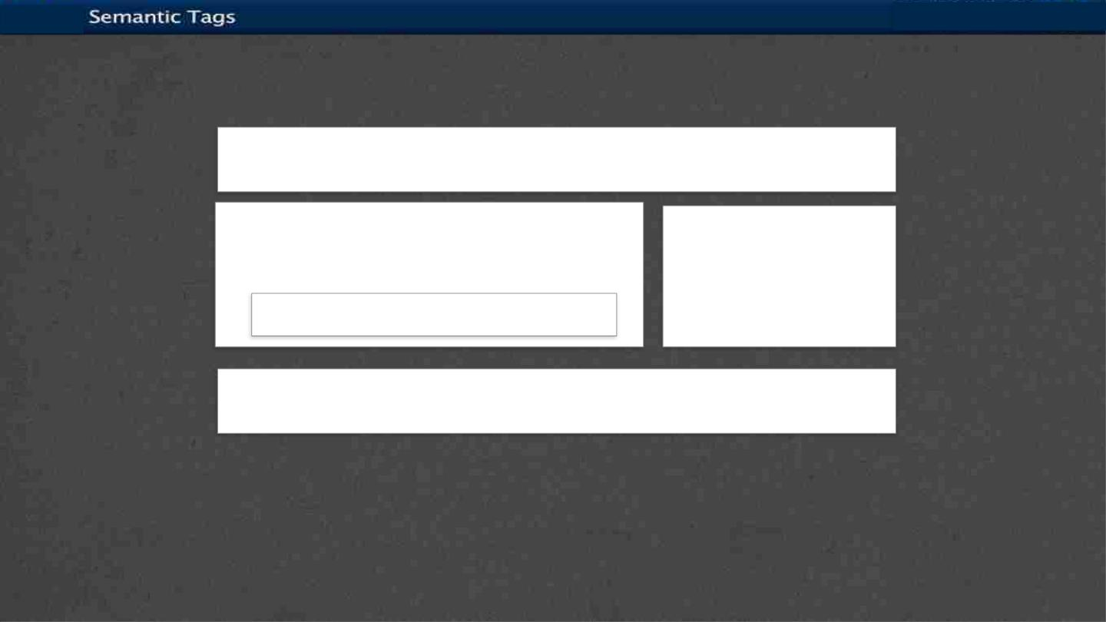
How to Design
<header>
<section>
<article>
<aside>
<footer>

Slide 24
Using Semantic Tags
• In the beginning (insert dramatic music of your
choice…) there was div
• <div> was a way to group related content together
• Divs almost always had special classes/ids
associated with them
<div class = “header”>…</div>
<div class = “section”>…</div>
<div class = “footer”>…</div>

Slide 25
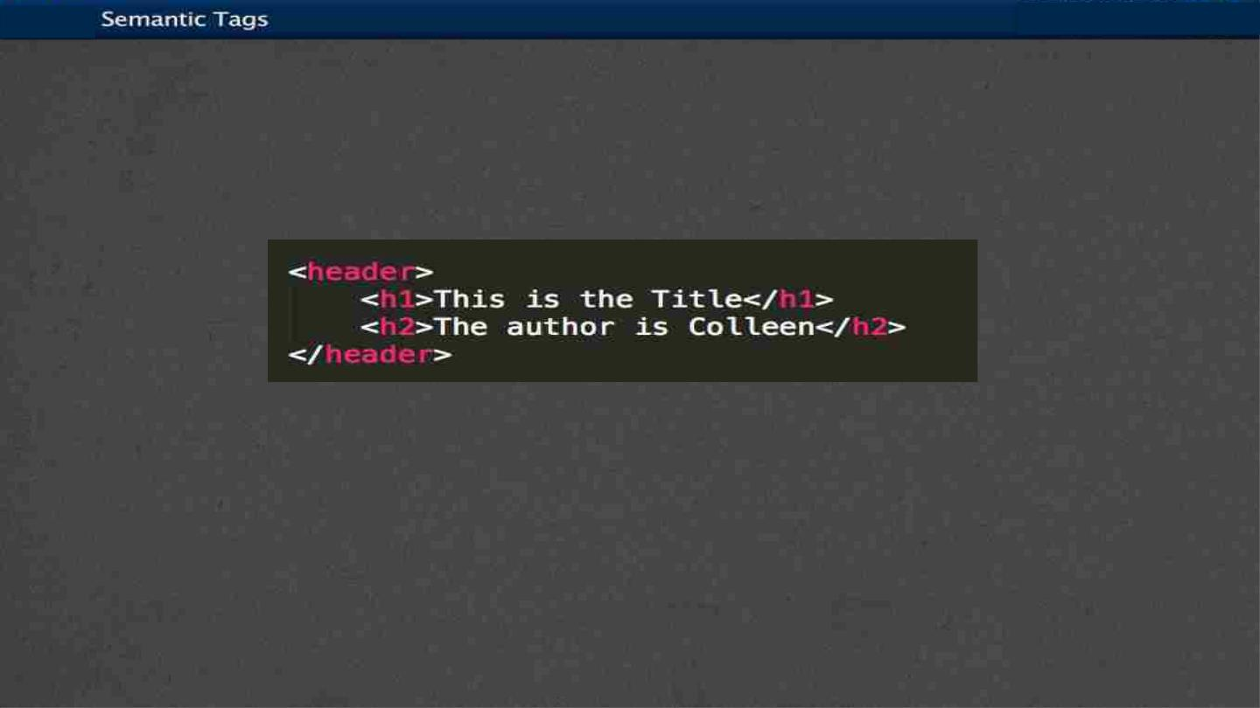
<header>
• A group of introductory or navigational aids:
title, navigation links, etc.
• Not to be confused with <head> or the
different headings.

Slide 26
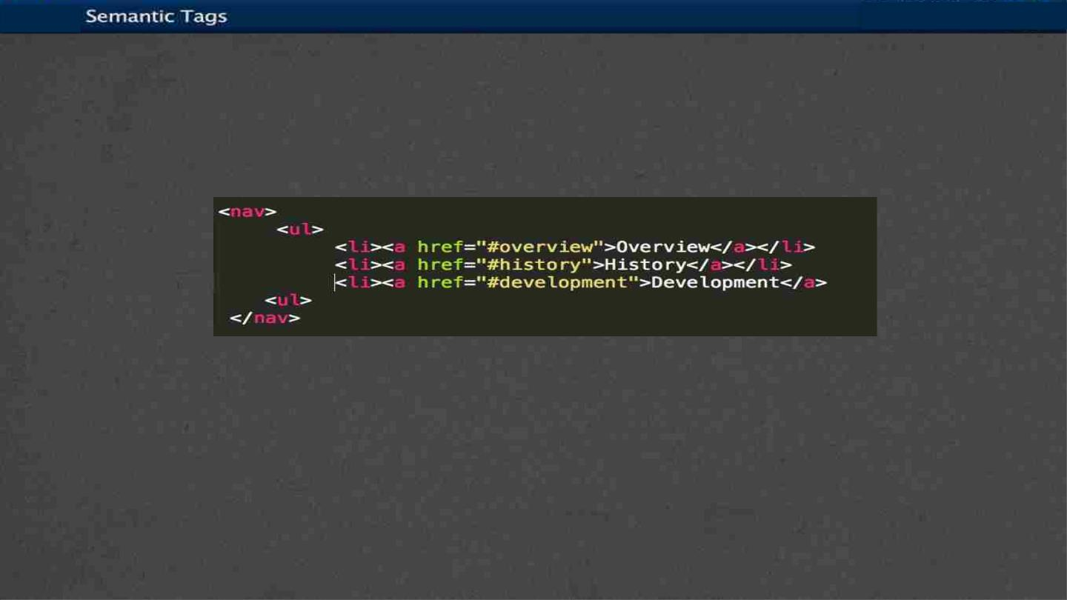
<nav>
• A section of the page that links to other pages or to
parts within the page.
• Often found in the <header> tag

Slide 27
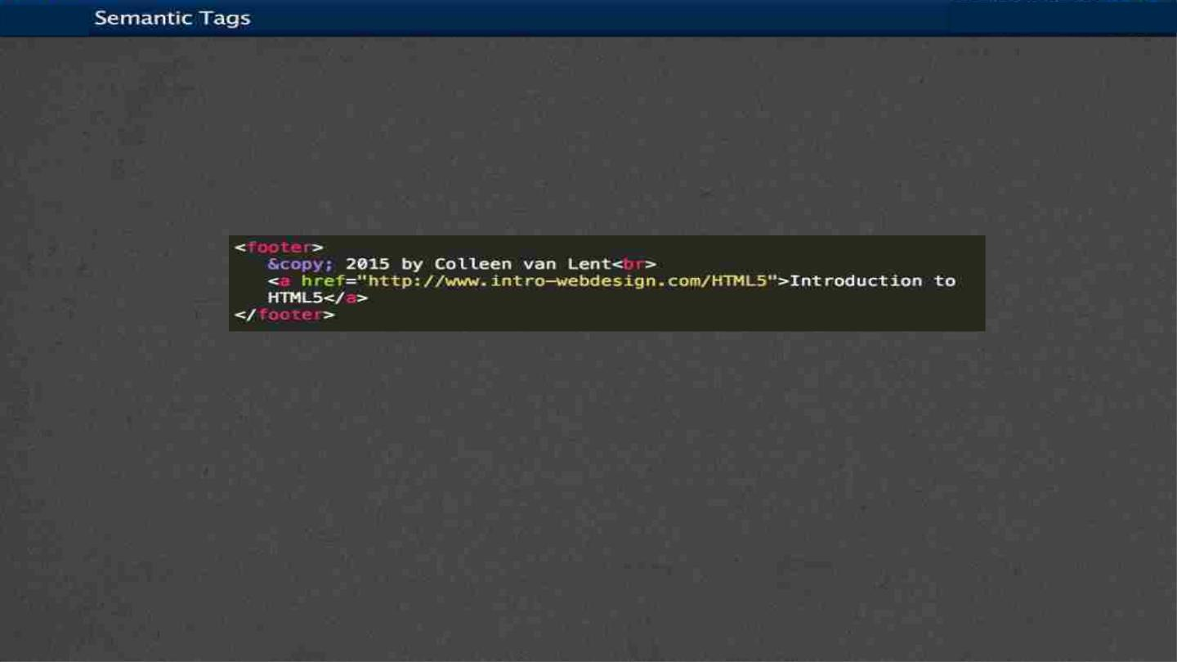
<footer>
• A section that contains info such as copyright
data, related documents, and links to social
media
• Typically at the bottom of the page, but not
required.

Slide 28
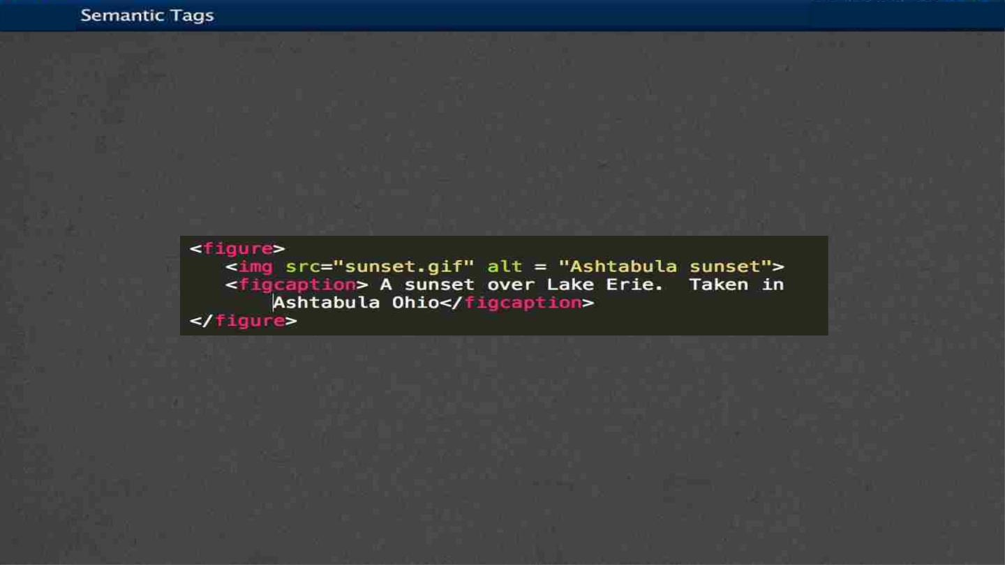
<figure>
• More semantics than <img>.
Can include:

Slide 29
Other New Tags
• Structural Elements
•
article, aside, main, menuitem, summary, section
• Form Elements
•
datalist, keygen, output
• Input Types
•
color, date, email, list
• Graphics Elements
•
canvas, svg
• Media Elements
•
audio, embed, source, track, video

Slide 30

Hyperlinks
Hyperlinks
Creating a linked document

Slide 31
Hyperlinks
Links
• Links are what make the Web a
web.
• The interlinked nature of the web
leads to the “knowledge” that
search engines appear to have.

Slide 32
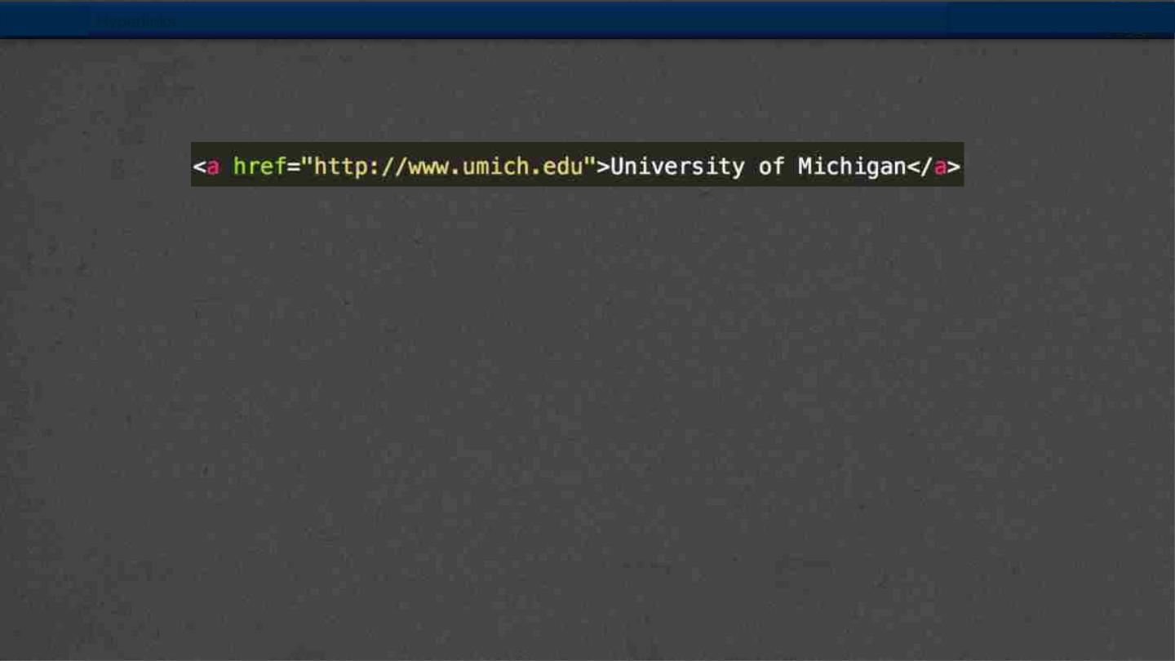
Hyperlinks
Anchor links
• The <a> tag stands for anchor link
• Needs a hyper-reference AND content
• href: reference to location of new
content
• content: the “clickable” part (text or
image)

Slide 33
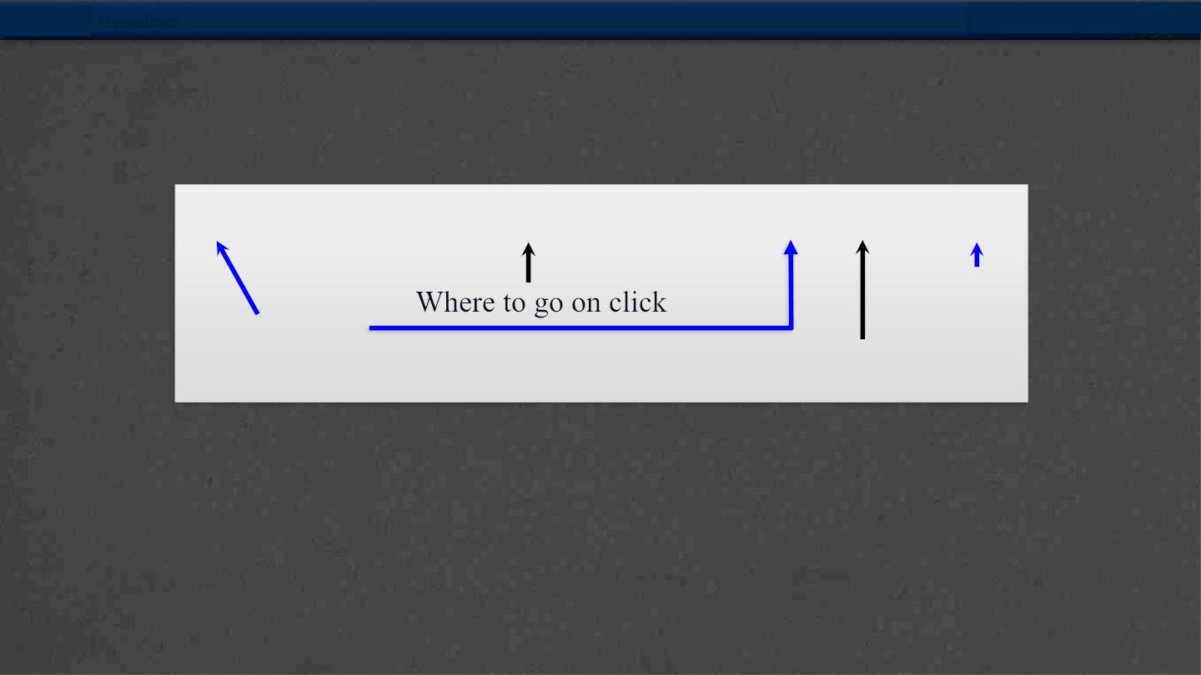
Hyperlinks
Absolute reference
<a href="http://www.intro-webdesign.com/">Web Design</a>
Closing
tag
Opening tag
Clickable text

Slide 34
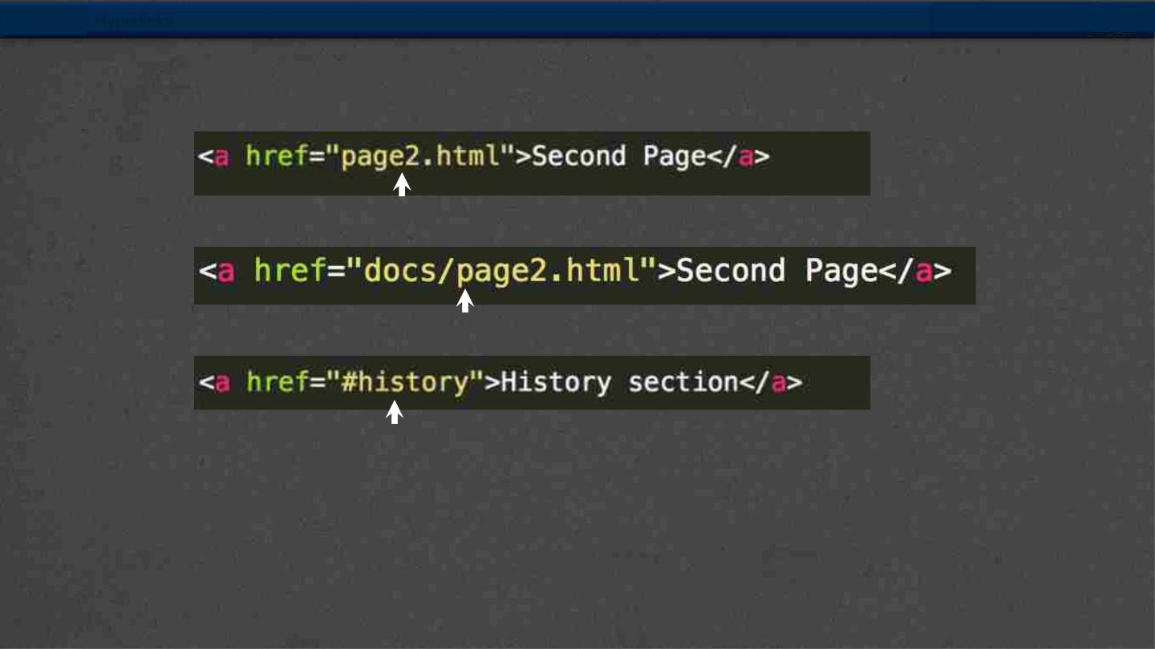
Hyperlinks
Relative References
Link to a local file in the same folder
Link to a local file in a different folder called “docs”
Link to a different location in the same file

Slide 35
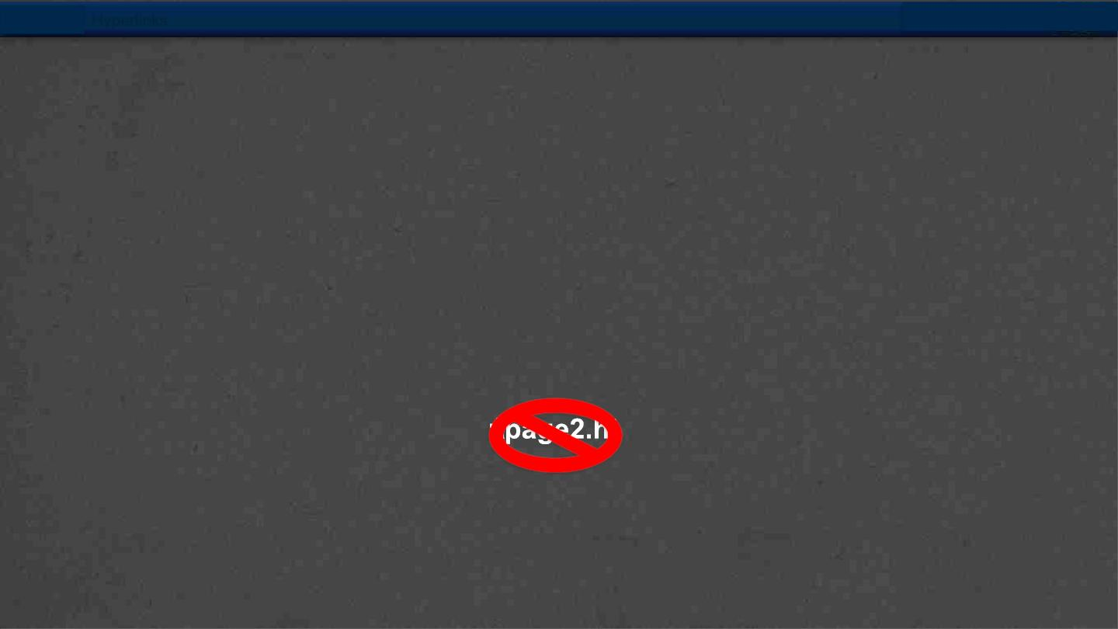
Hyperlinks
Absolute vs Relative
• When would you use absolute links?
• Are there any benefits to using local links?
• Your links should NEVER have folders that are
specific to your computer
C
ml

Slide 36
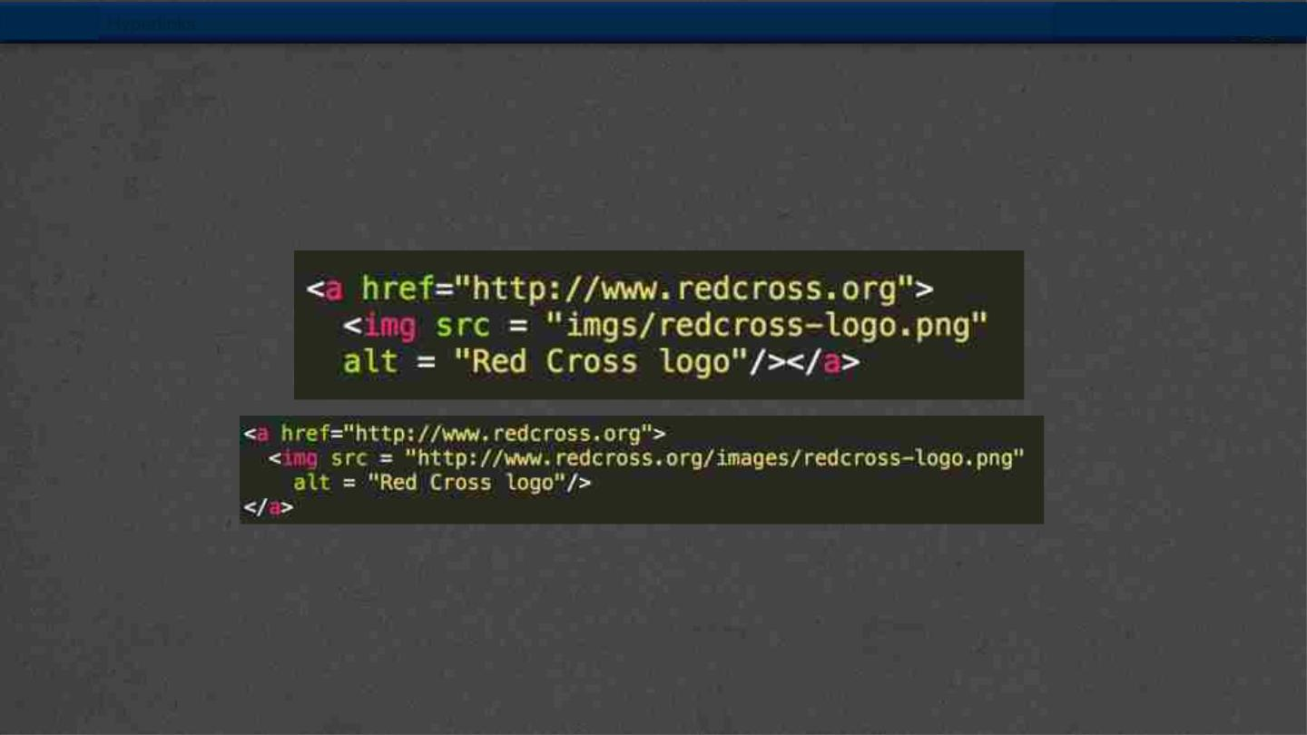
Hyperlinks
Using Images as the Link
• The “clickable” component doesn’t have to
be text.

Slide 37
Hyperlinks
Targets
• Anchors can take a target attribute
• _self - default action
• _blank – open in new tab or window
• _top and _parent

Slide 38
Summary
Module 01
▸ HTML Basics
▸ Explaining Tagging concept
▸ List creation and display
▸ Divs and Spans creation
▸ Attributes and information display
38

